Slide 1
Context switch in kernel level thread
From
Param Trivedi (121033)
Pooja Dhamija(121034)

Slide 2
Introduction
Context switch is suspending one process and executing other process.
When that process is called then it should resume from where it was suspended.
There are two parts:
Program counter
registers

Slide 3
How context switch works(1/2)
Suspend the progress of one process.
Store its CPU context in some location of memory.
Start other process and store its context in the temporary register.
After completion of that process, suspend it.
Resume the first process.
Retrieve the context and store it in the temporary register.

Slide 4
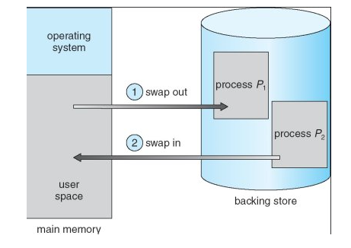
How context switch works(2/2)

Slide 5
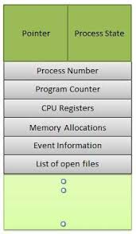
PCB structure

Slide 6
Implementation(1/2)
Changes made in kthread.c
Print the pid values
Results in log file
Using the dmesg command
Store it in some file
Dmesg >FileName

Slide 7
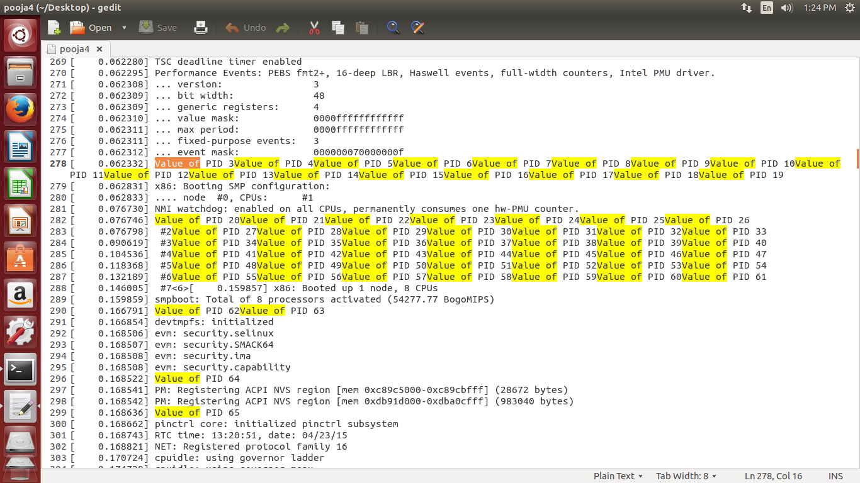

Slide 8
Implementation(2/2)
Tried to print the state of the thread using the function current_thread_info()
Problem in the syntax of the function and how to implement it.
Tried to print rbs and child_rbs values but there was no output.
As the process to be created manually but in kernel level to implement was difficult for us.

Slide 9
Current implementation(1/2)
Written the code in java at user level.
Algorithm
Start the first process by mystart() function
Suspend that process by mysuspend() function.
Resume the suspended process by mysuspend() function

Slide 10
Current implementation(2/2)
Main function
Create thread t1 and t2.
T1.start (start t1 thread)
T1.suspend(suspend the t1 thread and start t2)
T2.suspend(thread 2 suspends)

Slide 11
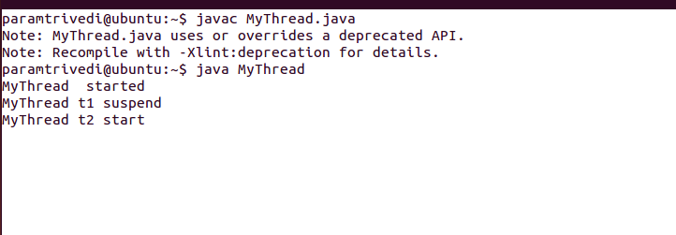

Slide 12
Thank you

